Slide 1
Senior Design Fall 2022
Nicholas Bowling, Sam Diener, Adonia Jebessa, Ming Zeng
Notes:
Adonia

Slide 2
The Team
Members:
Nicholas Bowling
bowlinnr@mail.uc.edu
Sam Diener
dienersh@mail.uc.edu
Adonia Jebessa
jebessah@mail.uc.edu
Ming Zeng
zengma@mail.uc.edu
Faculty Advisor:
Jillian Aurisano
aurisajm@ucmail.uc.edu
Notes:
Adonia

Slide 3
VR Sandbox for Intuitive 3D Design
The purpose of this project is to allow users to bring to life 3D modeling ideas in VR in an intuitive way
Reduce high learning curve of 3D modeling through VR
Will be intuitive for beginners, and allow for masterpieces by experts
Replicate tools of 3D modeling software in VR
Users will be able to export their work for use in other areas
Notes:
Adonia

Slide 4
Project Abstract
The idea behind this project is to create a VR sandbox for the intuitive design of 3D environments. So, we are looking to provide 3D animators, video game developers, and average consumers with the ability to play with, create, and edit 3D models and environments, all in an intuitive VR setting. We feel that the ability to create and extrude custom, “blocks” to build with opens up infinite possibilities. Implementing adjustable player and object scaling only increases the creative options. From being a fly on the wall, to a monster towering over a city, VR experiences and environments can be easily created and shared. There is so much that is possible, even with already existing limited tool sets. This can be seen through wonderful communities like Minecraft, where people enjoy collaborating actively.
Notes:
Sam

Slide 5
User Stories
As a VR Game Designer, I want to be able to create 3D models with a proper sense of scale, so that when imported into my VR game, they can be integrated appropriately
As an Artist/3D Modeler, I want to be able to create and edit 3D models, so that I can express myself intuitively and extensively as an artist.
As a Gamer, I want to have a VR environment to play with 3d shapes, so that I can have fun in VR.
As a Student I want to learn more about 3D modeling techniques, so that I can apply my skills to my future projects and career.
Notes:
Sam

Slide 6
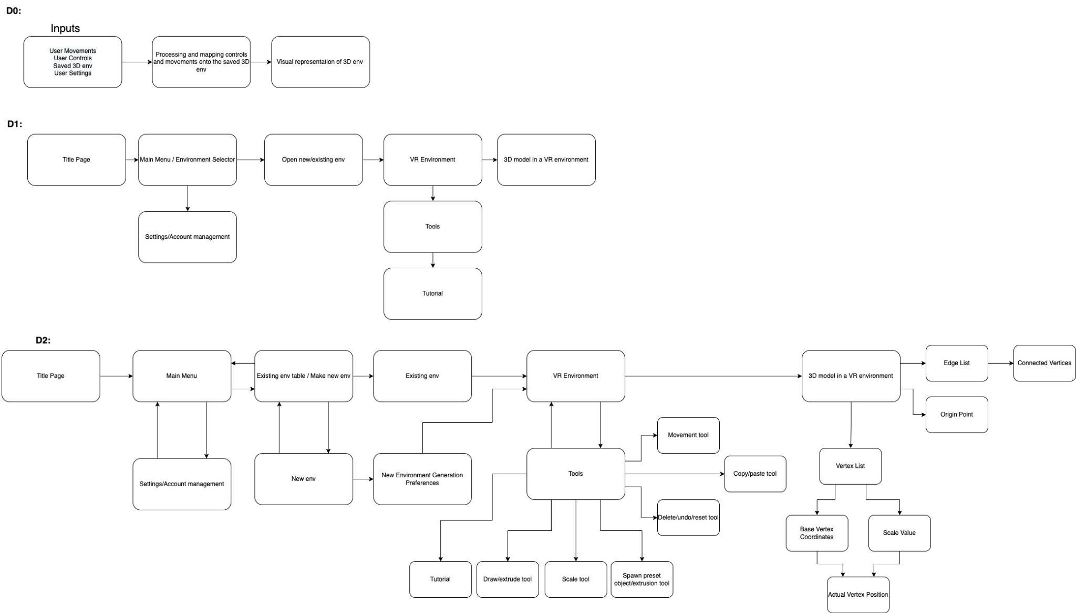
Design Diagram
Notes:
Sam

Slide 7
Project Constraints
Professional
None of us have done any work in video game or VR development in the past
Could we commercialize the product if not open-sourced?
Economic
What game development software is free and what will need to be purchased?
We can’t all purchase VR headsets for testing
Legal
Are there any patents already made for technology that we are developing?
How can this software be legally distributed?
Security
Can we keep the project private if not open-sourced?
Social
Will people use the product as intended?
Notes:
Nick

Slide 8
Review of Progress
During this semester we have primarily focused on the planning stages of development.
We have put together the list of features that we want to include in our software and have decided the order in which we will add them.
For each feature we have decided on, we have discussed how it will be implemented and at which stage of the project we will begin to work on it.
We have done preliminary research on how each feature could be added. This has entailed researching how similar systems have been done in other software and what tools we could use in order to create our own version.
Notes:
Nick

Slide 9
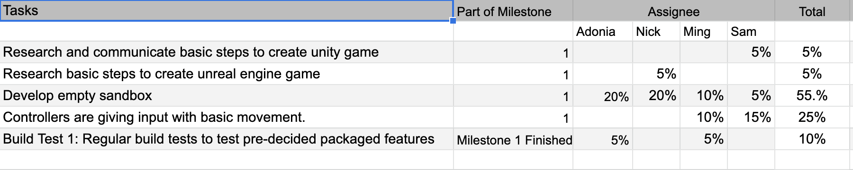
Division of Work
Our system for dividing work is based upon making sure that each team member is doing an even share of each milestone.
Every milestone has a list of tasks each with a percentage weight that, when added together, make 100%
Every team member will be assigned a certain percentage of each task.
When added together, all of a team member’s assigned work will add up to 25%.
This allows us to assign weights to each task and the efforts that each team member is putting toward that task.
Notes:
Nick

Slide 10
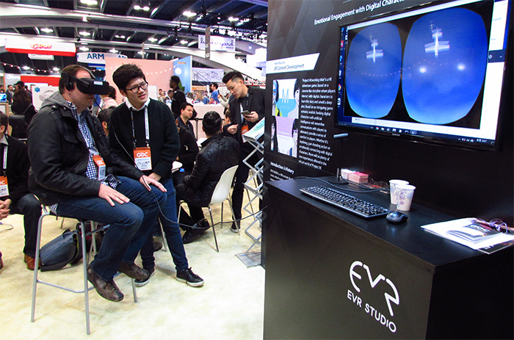
Expected Demo at Expo
We will have an interactive demo of the game available to play for expo attendees (similar to photo)
A teammate will provide their VR headset which will be connected to a PC
Other conference goers will be able to watch participants gameplay from a TV/Monitor
We will also have screen recordings of artists’ gameplay running on a loop
Notes:
Ming

Slide 11
Expected Progress
Research different engines and environments for VR.
Delegate tasks to each person in the group.
Get hands on experience with different VR software.
Set up the framework of the developments process.
Begin development.
Notes:
Ming

